Slide 1
Motion Planning
Initial Proposal

Slide 2
To do:
Explain her the topic briefly and then ask her for more related paper links.
Finding specific project related papers - Common
Select path planning algorithms from review papers – Silva and Khizar
Setup Unity and review it – Sathwik and Ajith
Read up on evaluation metrices – Common
Computational geometry Book

Slide 3
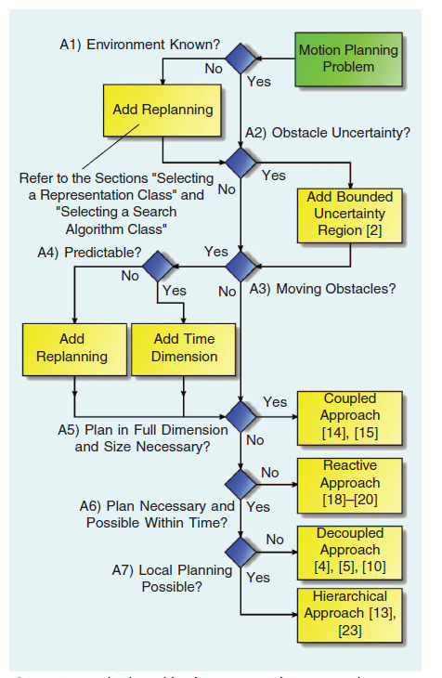
Talking points
The motion planning paper using reactive approaches and hierarchical approach
Local planner ?? – Reactive??
Global planner ?? RRT or RRT*??
More specific papers for project

Slide 4
Project components
Problem description | Autonomous navigation of mobile robot in a cluttered (dynamic and static obstacles) hospital environment.
Application impacts | Medical supply transportation inside a hospital for isolation
Related work | Hoy, M., Matveev, A., & Savkin, A. (2015). Algorithms for collision-free navigation of mobile robots in complex cluttered environments: A survey. Robotica, 33(3), 463-497. doi:10.1017/S0263574714000289 J. J. M. Lunenburg, S. A. M. Coenen, G. J. L. Naus, M. J. G. van de Molengraft and M. Steinbuch, "Motion Planning for Mobile Robots: A Method for the Selection of a Combination of Motion-Planning Algorithms," in IEEE Robotics & Automation Magazine, vol. 23, no. 4, pp. 107-117, Dec. 2016, doi: 10.1109/MRA.2015.2510798.
Method | Implement these methods as ROS package;
Evaluation | Yet to decide based on algorithm; Real time complexity, space and time complexity; computational time complexity
Platform | in the ROS- and Unity-based simulation
Team leader | Khizar Mohammed
Project capacity | Ajith Kumar Jayamoorthy, Khizar Mohammed, Krishna Sathwik Durgaraju

